Slide 1


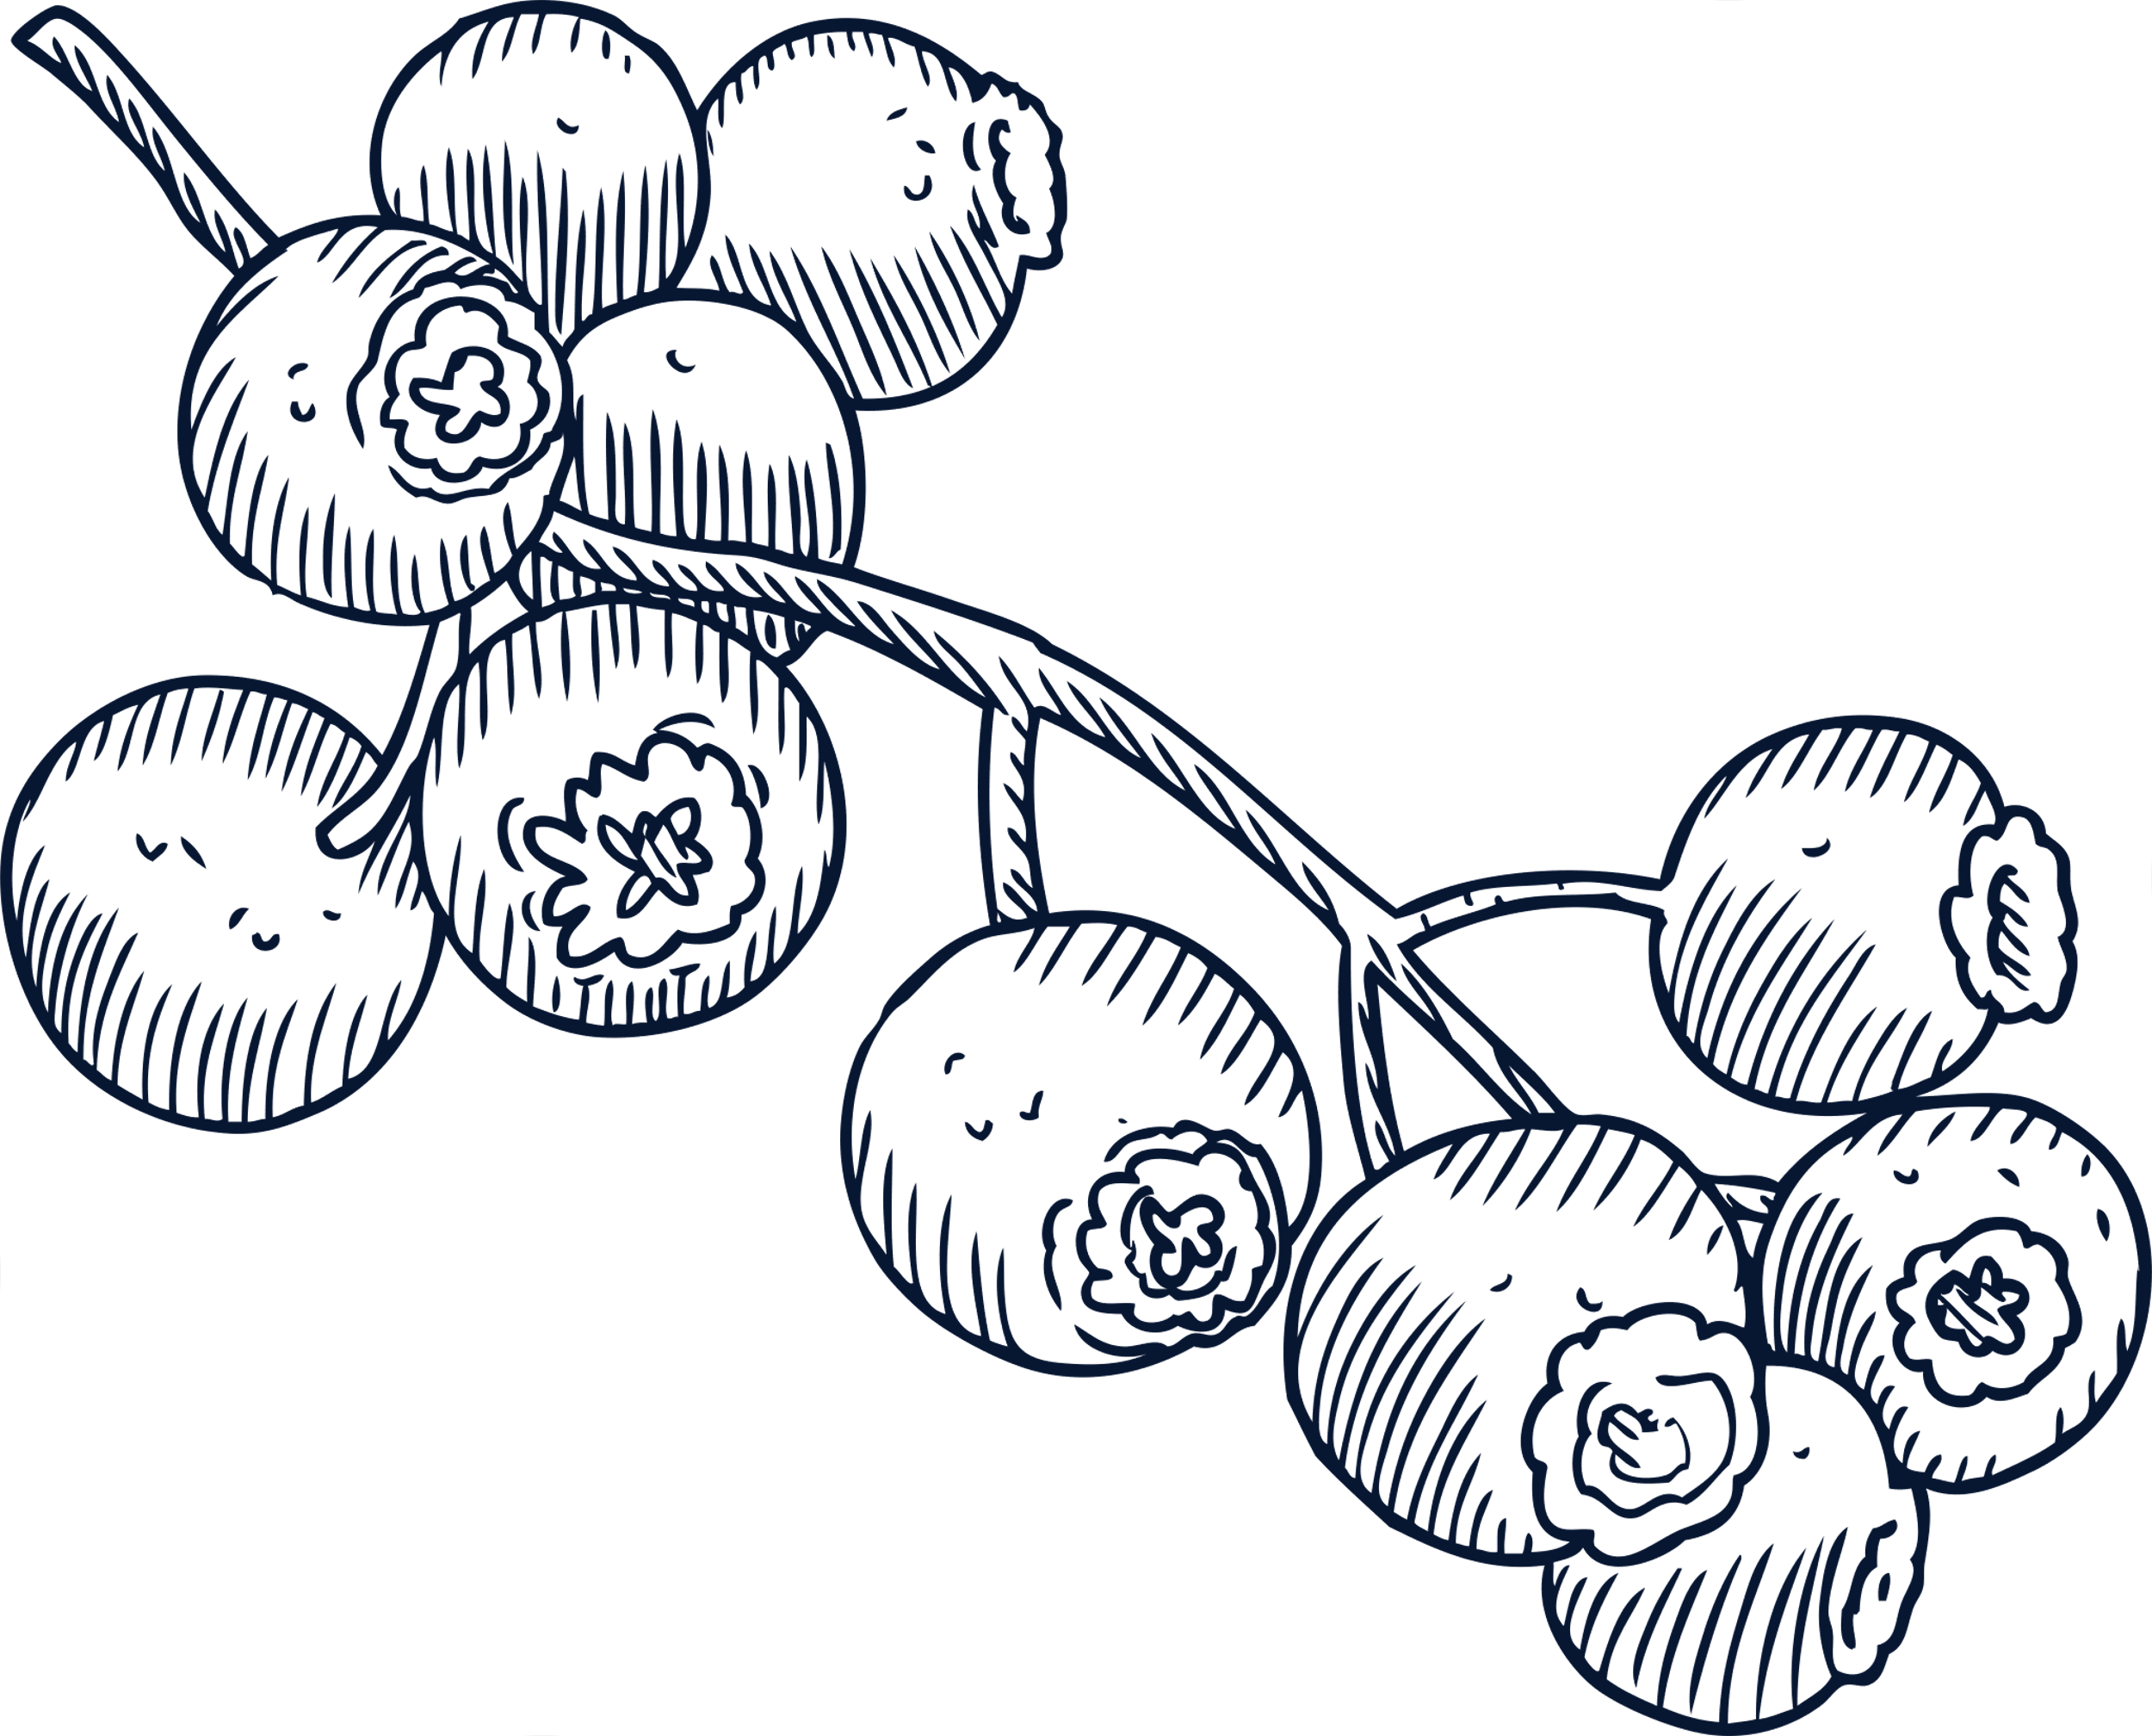
BSC (HONS) COMPUTER SCIENCE
(SOFTWARE ENGINEERING)
(UK BATCH 06 )
STUDENT NAME: MEWAN DIMALSHA
STUDENT ID: 2221632

Slide 2
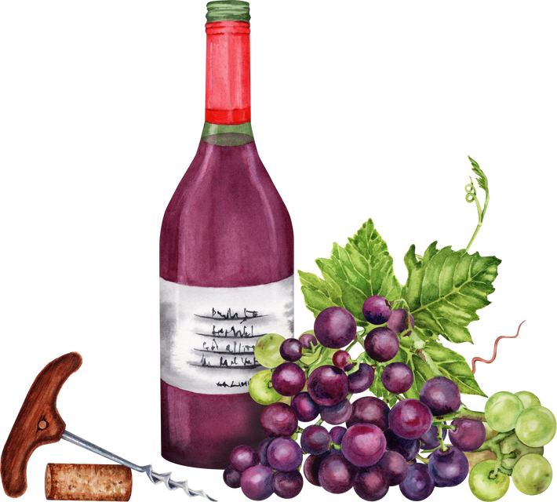
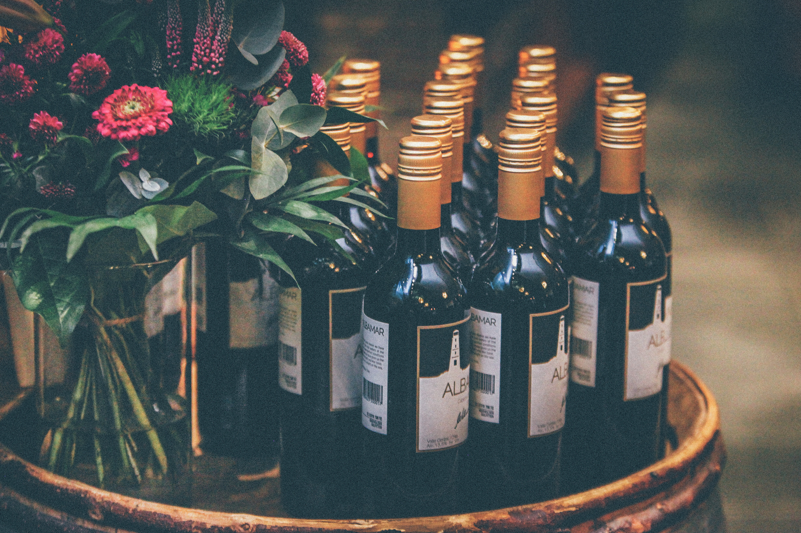
FindFineWine: A Machine Learning-Based Web Application to Design and Implement a Wine Recommendation System Based on User Profiling Factors.

Slide 3

When people drink the same wine all the time or want to try something new, it might be challenging to find the appropriate wine for their individual tastes.
BackGround
This project propose a solution: A Web app that simplifies wine selection by personalizing recommendations to cutomers unique preferences.

Slide 4

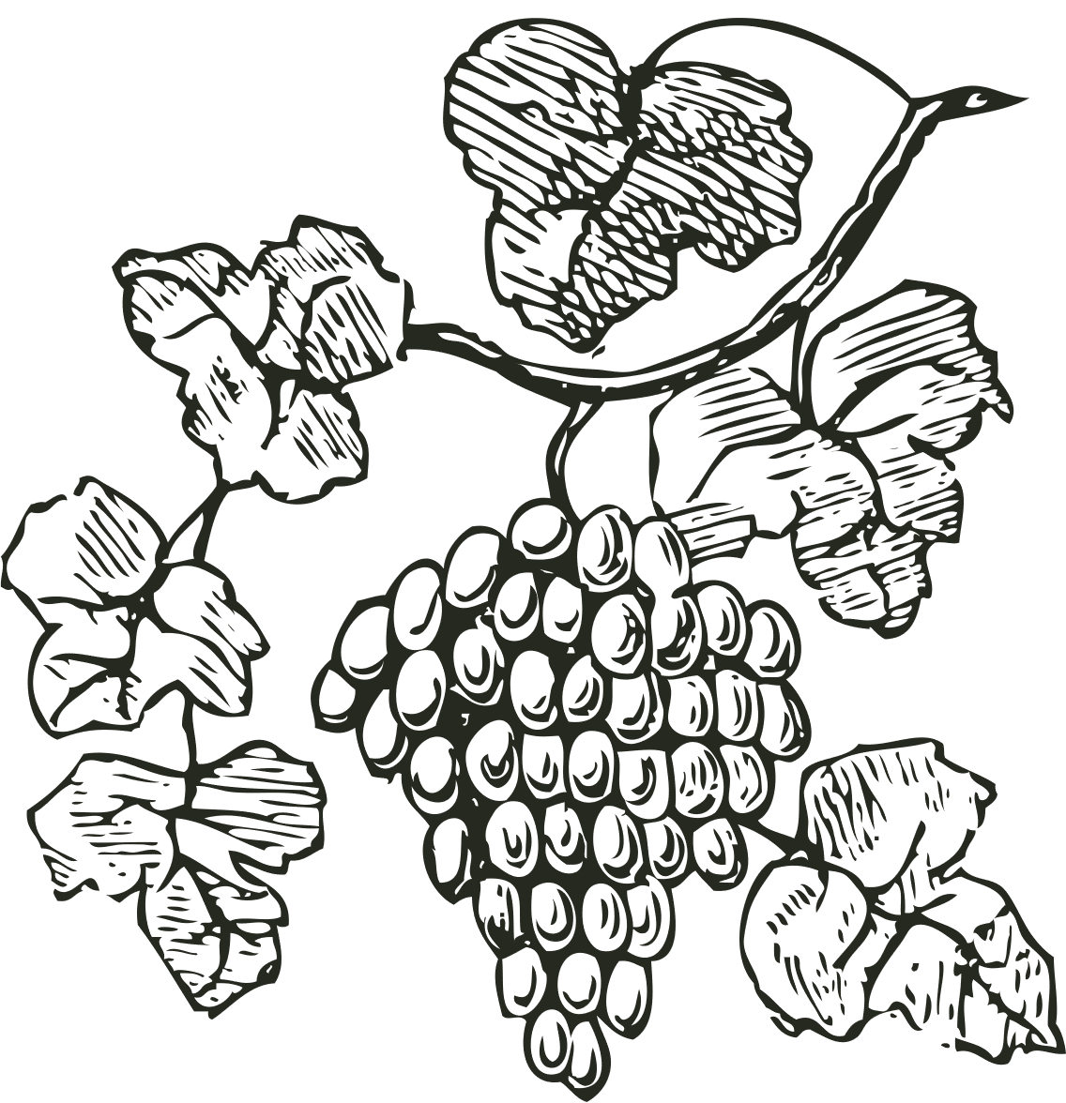
Suggesting the best wine to choose based on the user's preferred wine type, grape variety, gender and occasion.
Consider the user’s budget and filter wines within their price range.
Aims
Provide essential details of all wines (Name of the wine, price, description, region)

Slide 5
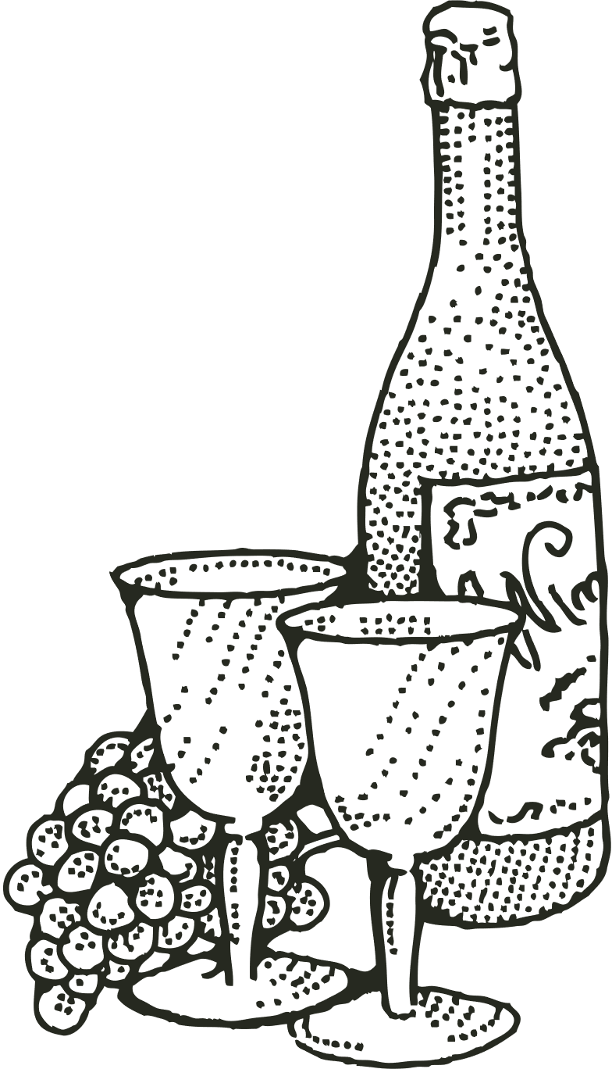
What factors influence user preferences when selecting a wine?
How can these factors be effectively captured and analyzed in a recommendation system?
Academic Questions
In what ways can the user interface and overall user experience of a wine recommendation system be optimized to enhance user satisfaction and engagement?

Slide 6
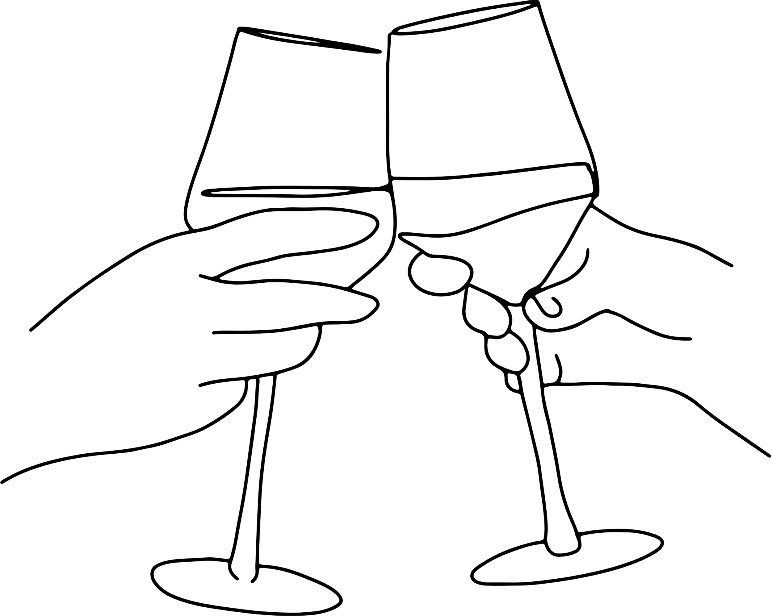
Design the recommended system based on the user’s inputs as necessary.
Recommend the best wine based on the user's preferences.
Objectives
Create a simple platform for customers to discover and buy the best wine through the application.

Slide 7
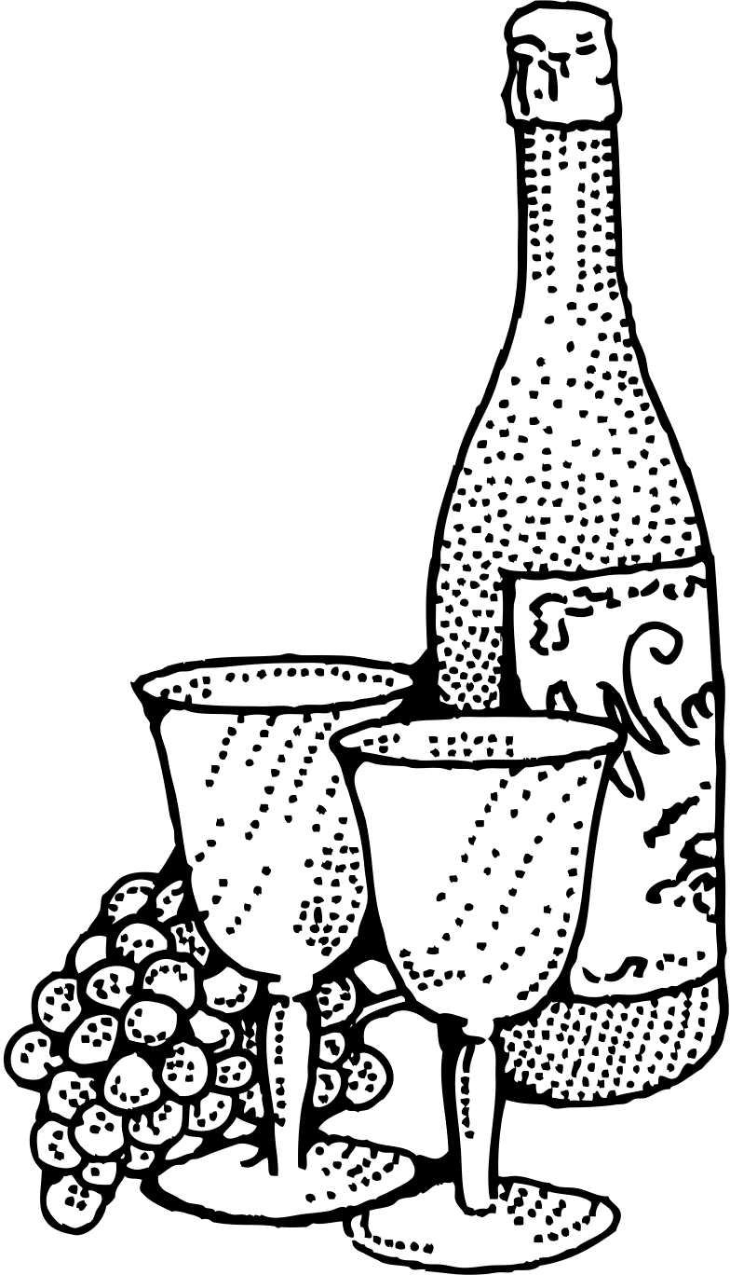
The project will focus on developing a web application to target wine lovers and casual consumers.
Scope of the Project
The website consists of wine for red wine, white wine, and rose wine.

Slide 8

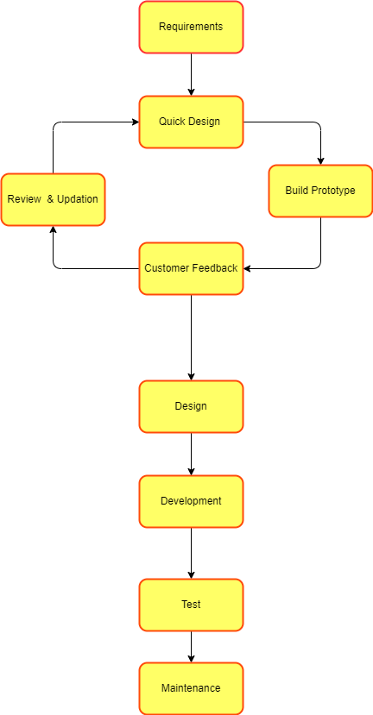
Methodology
The methodology that is used to develop this web app is the prototype methodology.

Slide 9
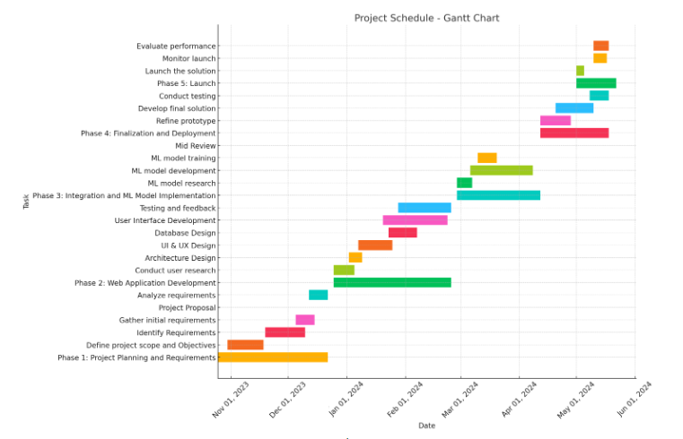
Gantt Chart

Slide 10

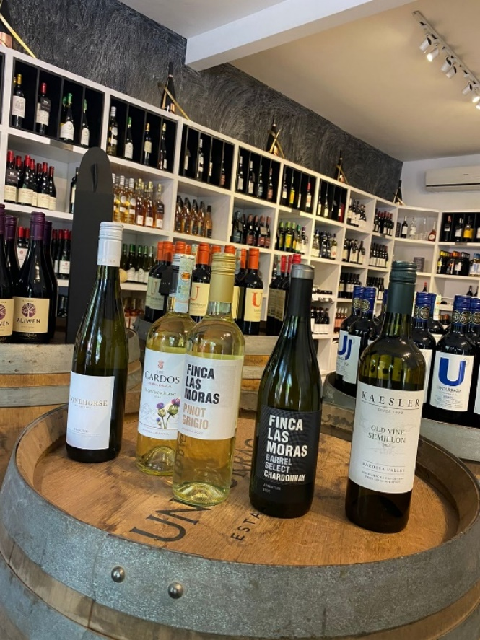
Data Gathering Methods
PRIMARY DATA COLLECTION
Local Wine Store(House of Wine) and websites
SECONDARY DATA COLLECTION
Published research papers, Published journals

Slide 11
Recommendation Part
Web Site design – node js, next js
Database – MongoDB
Data model - K Nearest Neighbor and Random Forest Regressor

Slide 12
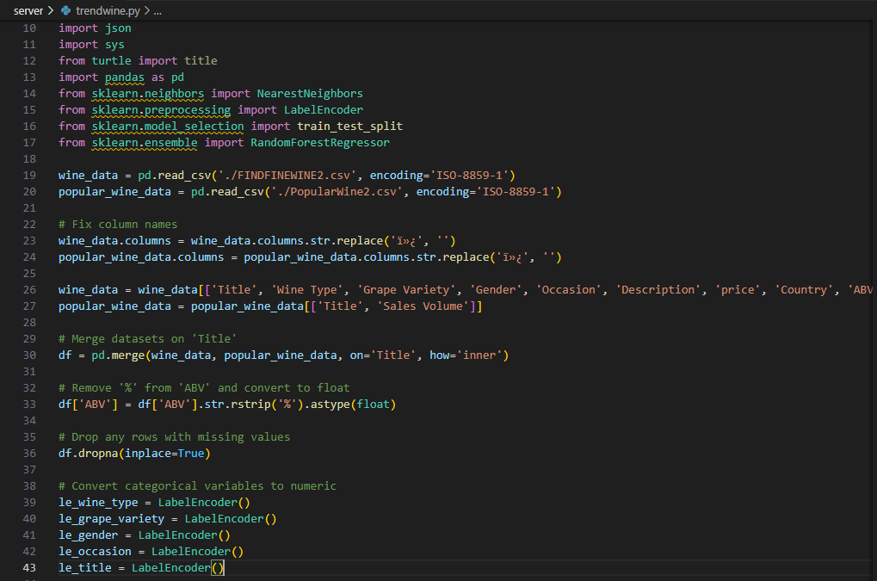
Wine Recommendation Code

Slide 13
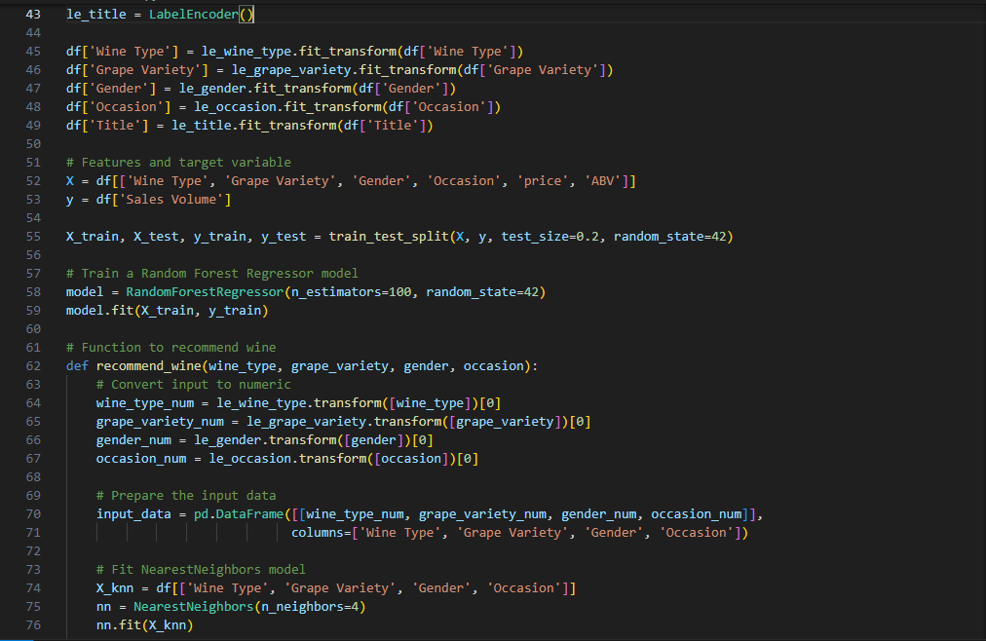
Wine Recommendation Code

Slide 14
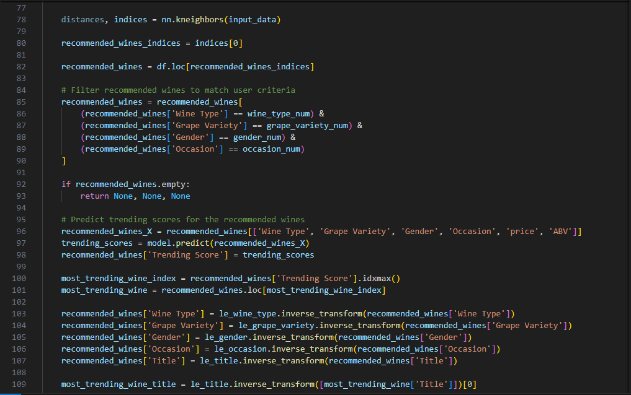
Wine Recommendation Code

Slide 15
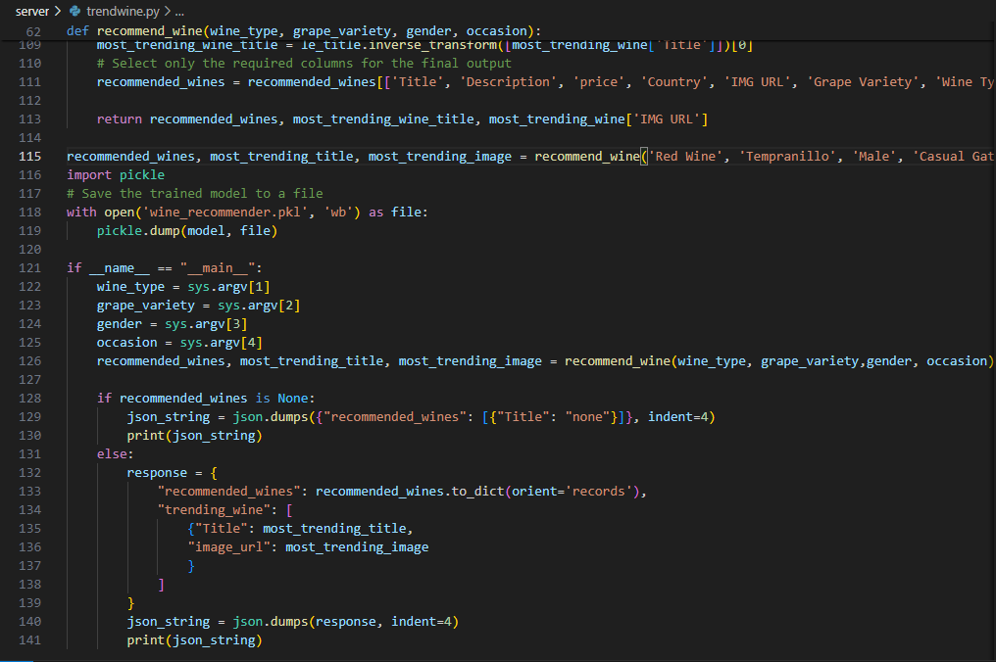
Wine Recommendation Code

Slide 16
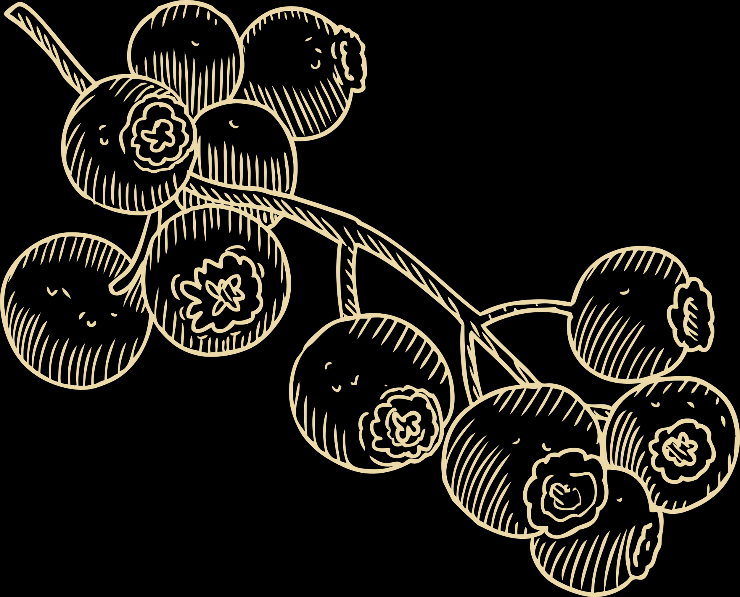
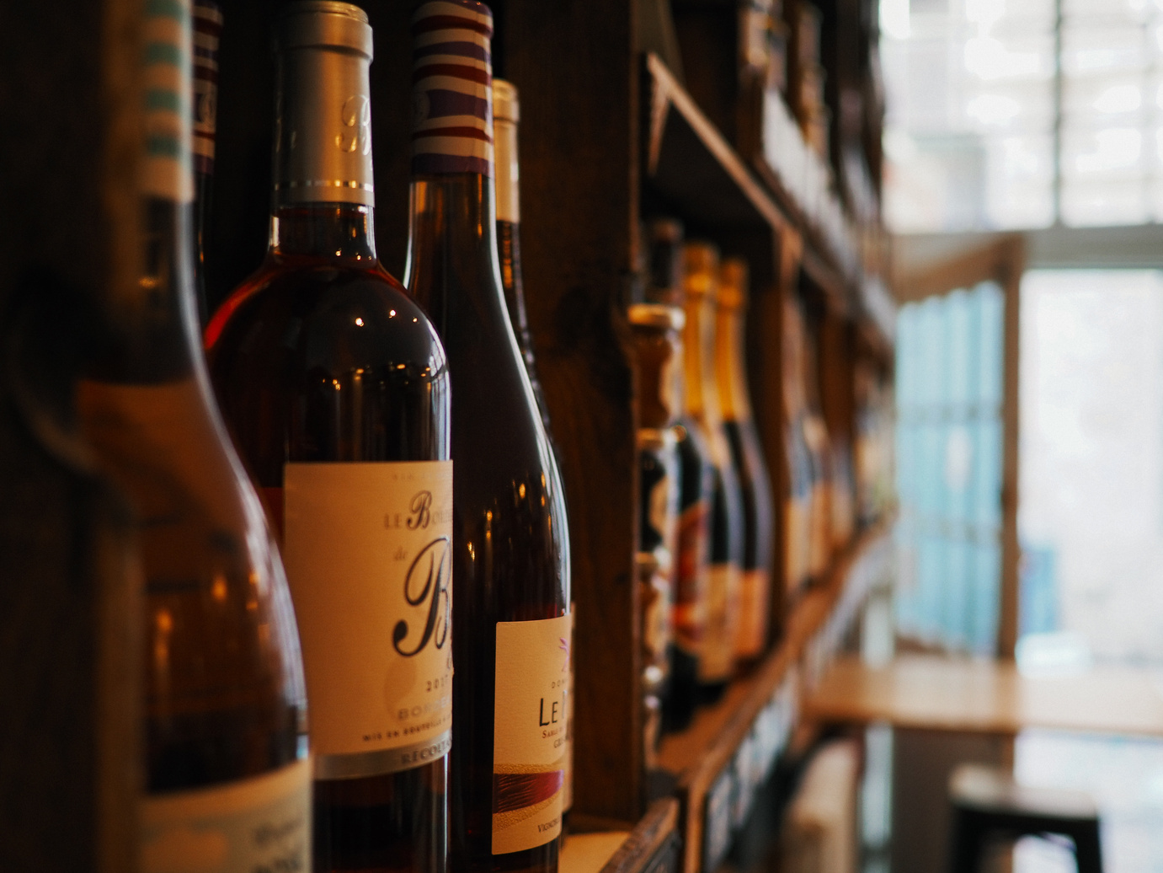

THANK YOU!
A bottle of wine contains more philosophy than all the
books in the world.
LOUIS PASTEUR

